Slide 1
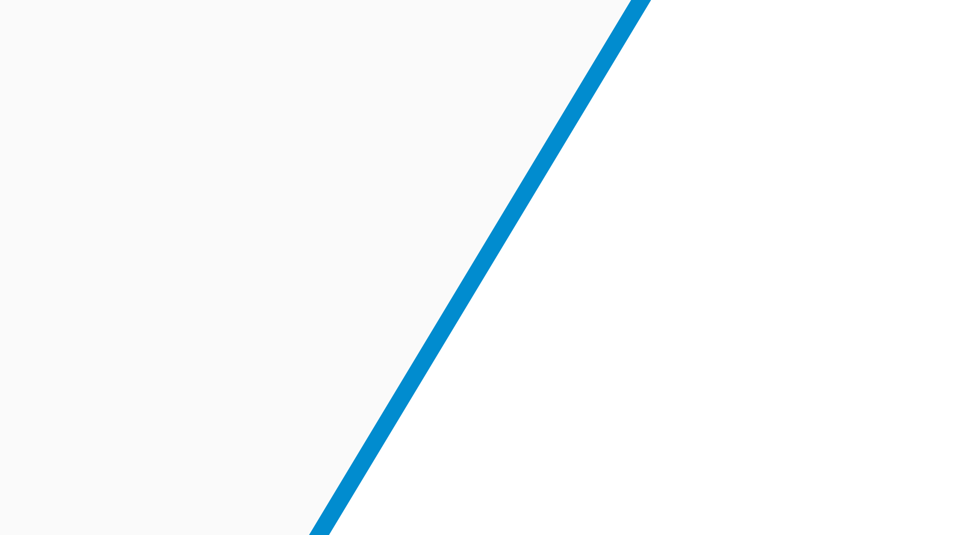
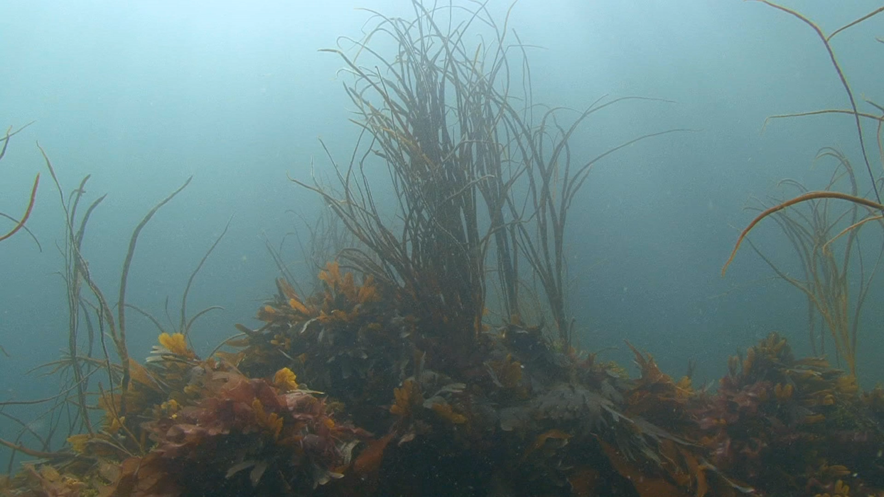
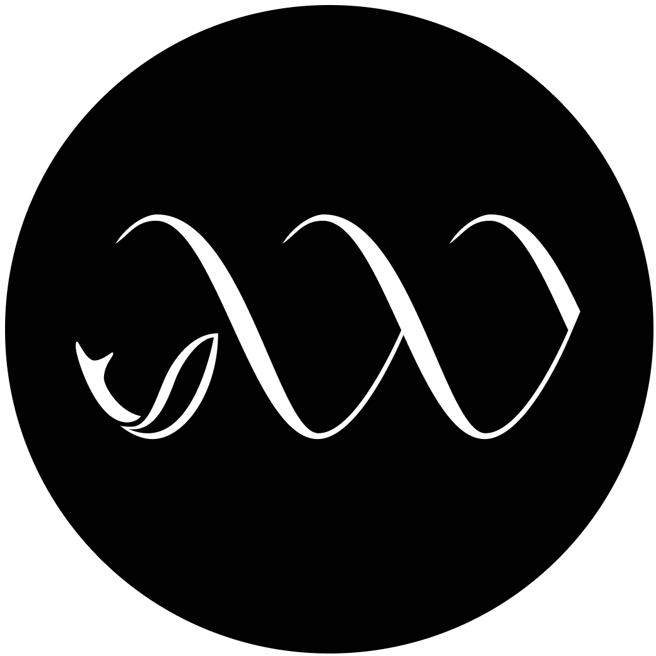
Whitney Lab Online
Project Development
Notes:
This presentation outlines the initial development pipeline for the design of the Whitney Lab online learning system. The Whitney Laboratory for Marine Bioscience is a full time University of Florida research center for biomedical research and biotechnology located in St. Augustine, Florida. Whitney Lab is dedicated to using marine model animals for studying fundamental problems in biology and applying that knowledge to issues of human health, natural resources, and the environment. Scientists at the lab are on the front lines of biodiversity, neuroscience, sensory biology, ocean health, and cell regeneration.

Slide 2

Information Gathering
Purpose
Goals
Audience
Content
Notes:
My initial goal was gathering as much information as possible and getting to know the content experts from Whitney Labs we would be working with.
(CLICK) Purpose - What was the purpose of the project? Were we simply providing information? Promoting a service? Was there a product to sell? Initial discussions pushed the project in the direction of creating several hyperfocused modules designed to provide students with learning material on topics regularly studied at the lab.
(CLICK) Goals - Whitney wanted to teach students something interesting about marine biology, and include an experiment or assessment the students could complete at home to supplement the covered material. They stressed a fun learning environment with as much interactivity as possible, along with a professional brand and appearance fitting a a scientific laboratory associated with the University.
(CLICK) Target Audience - The initial target audience was described as students ranging from K-8 and possibly up to 12. The appearance of the modules would need to be catered to the age group, while still being consistent and professional.
(CLICK) Content - The content would vary based on the age group. Early discussions centered around some type of a learning portal where offerings could be filtered based on topic and age. There would be a mixture of text, images, videos, and interactive elements designed to let the students explore at their own pace, discover hidden information throughout the module, and assess their understanding of the content being provided.

Slide 3
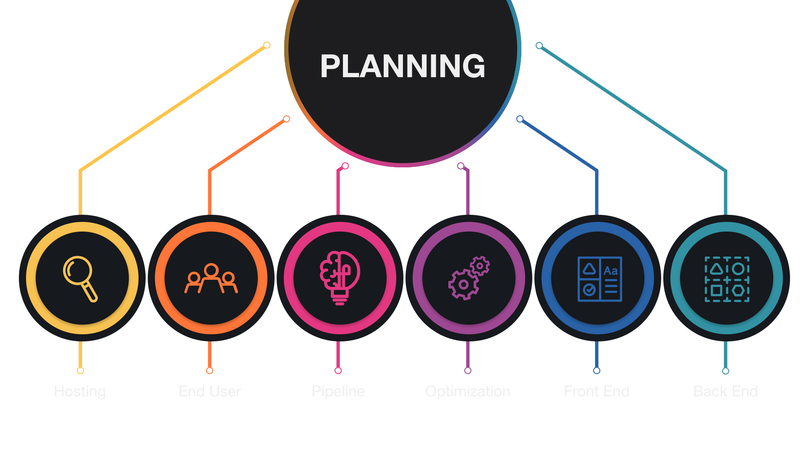
Planning
Notes:
A task analysis revealed the outline of my development planning.
Hosting - I would not have the ability to plug our modules into the university website, which meant I would need a custom solution. The client’s request was that I handle hosting, while also building the modules in a format that could be handed off at any time and be hosted elsewhere without our involvement.
End User - I also did research on who was going to be offered the modules initially, and what type of technology would be available to this group. The lab requested I prepare to do a trial run with three local schools, with the plan of analyzing feedback from teachers, making adjustments, and ultimately expanding the offering throughout Florida and beyond. The schools would not be providing students with hardware, however I was told most students accessed their remote learning on laptops or iPads. Specifics were very limited. I decided I would not have a specific target device or resolution minimum, and would optimize all of the modules for all OS and devices, smart phones through desktop.
Development Pipeline - Hosting requirements pointed to a static site generator at the core of my dev pipeline, since I could not depend on a remote database or server side rendering of any kind since I may be totally out of the loop at some point, and I did not have a long term support contract in place. With the intent that I would be building many of these modules overtime, I compared various techniques I've used in the past and ultimately decided that I’d build the modules using React, leveraging a course framework called Hayden I had developed for a different client.

Slide 4
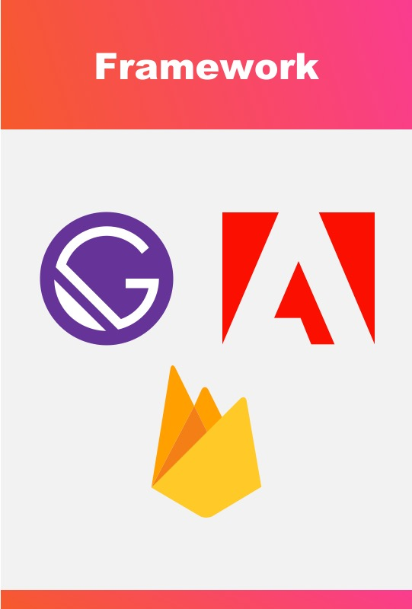
Design
Notes:
Front End Development - for the front end, I know that I need a (CLICK) static site generator. I want to work (CLICK) with React, and to make life easier for myself, I want (CLICK) MDX for the source of a majority of the content.
The heavy weights here are (CLICK) GatsbyJS and NextJS. I have recently completed a complete revision to my company website using Gatsby. Also at the time, Gatsby’s image optimization was further along than Next’s. Having the Gatsby workflow fresh in my mind and knowing it checked all the boxes for my delivery requirements, (CLICK) I can use this as the primary front end framework.
Back End Development - The (CLICK) project repository will contain the MDX files, providing an easy version control solution and simple editing workflow.

Slide 5
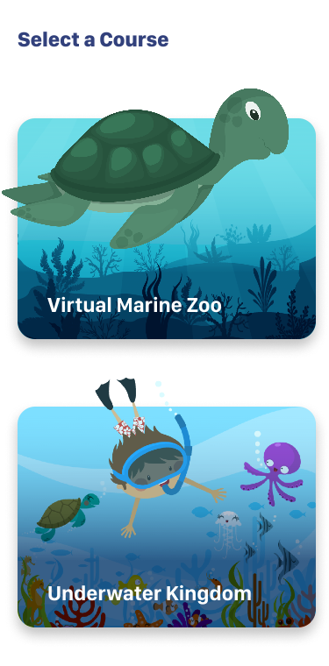
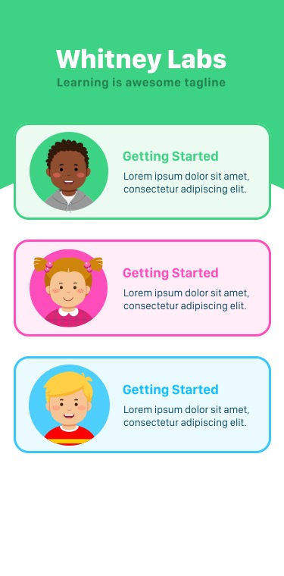
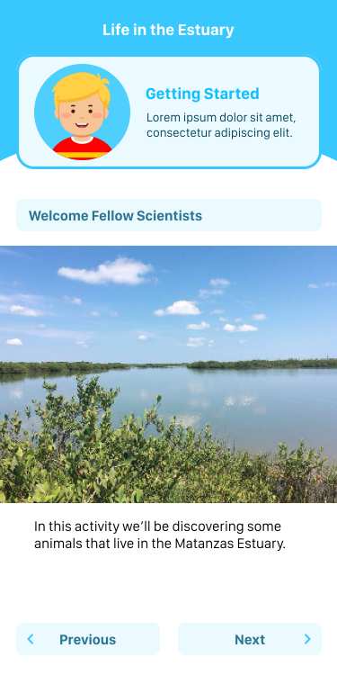
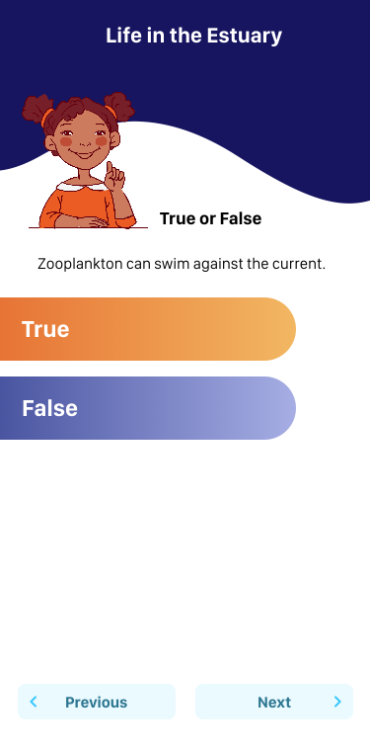
Design
Notes:
The design aspect that for the project is the younger audience, specifically K-3. I know I needed to spend time conceptualizing what types of UI elements would work with this audience. Without knowing the first topics that may be covered, I began exploring design concepts that would be visually engaging for a K-3 audience.

